Slide 1
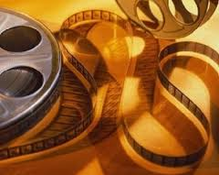
Audio - Visual text
Enhance the experience

Slide 2


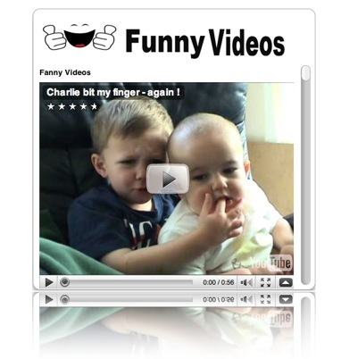
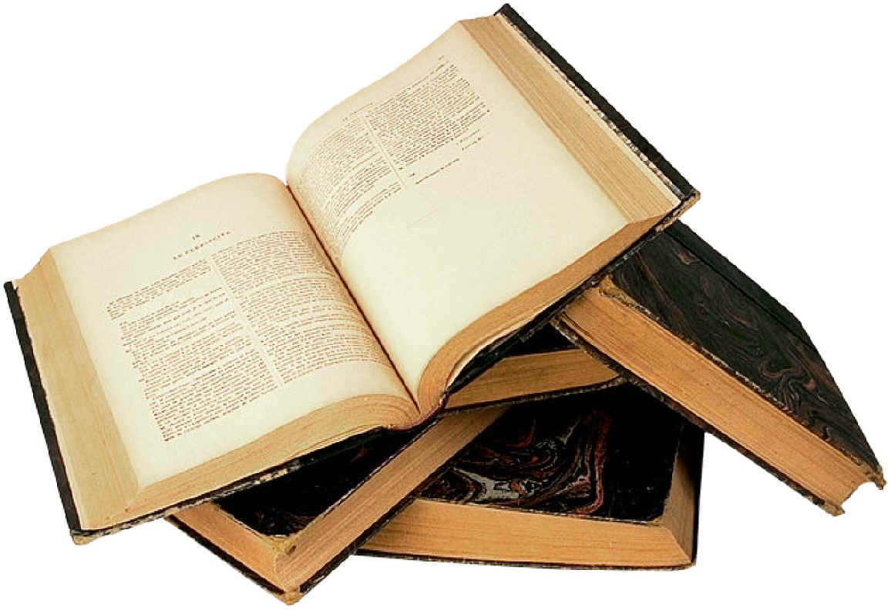

A text is anything which enables meaning making.
Books, websites, videos, even smiles and gestures
can be thought of as texts.

Slide 3
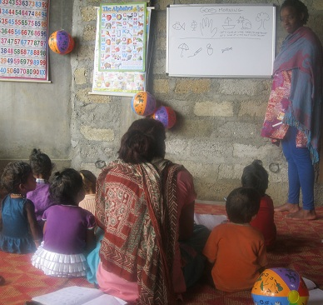
A visual text makes meanings
through images or
meaningful patterns
and sequences.

Slide 4
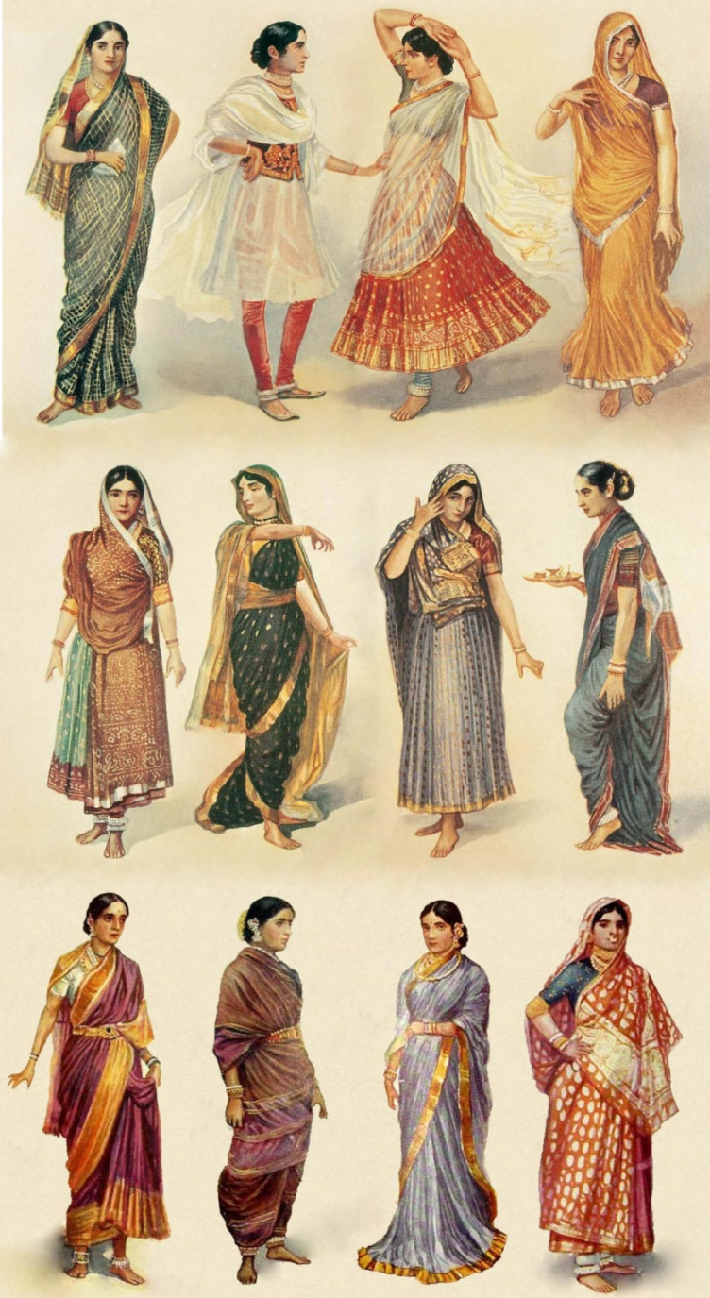
They can be
printed as an atlas or
electronic as a DVD
fiction as a movie or
nonfiction as a street map
Visual messages are everywhere:
street signs
books
television news
buildings we inhabit
clothes we wear

Slide 5
Films can be read as texts
Images should be interpreted just as we would read the imagery in a written passage
The film's plot, acting, genre and socio-political/historical context are the first things that are read.

Slide 6
How to read an audio visual text?
Mise-en-scene: What is in a frame? What is excluded? What is centered?
Depth of Focus: What is in focus and what is blurred? Focus creates foreground and background.
Lighting: What is lit and what is not? Is the lighting harsh or soft? What colors are highlighted?

Slide 7
How to read an audio visual text?
Camera Angles and Movement: It can be a close-up or a long shot.
Movement slow or fast-paced, disorienting or "grounded," creates psychological moods in the viewer.
Music: Music adds important emotional components to film.
Editing: Are the scenes long and lyrical, or short and clipped?

Slide 8
What is a Documentary?
It is not a film
Documentary is a depiction or direct filming
("cinema verité") of a real life situation rather than a fictional story.
Documentaries are portraits of real life,
using real life as raw material
and with claims to truthfulness

Slide 9
The Great Indian Railway as a Documentary
A representation of reality and not a work of fiction
Largest railway system a single management
The largest employer
A potent unifier
Bridging cultures in the country

Slide 10
The Great Indian Railway as a Documentary
Integral part of our shared history
- Tracking history to the British era
- Communal rail systems in Mumbai
Life-line of our cultural, political and social fabric
- Class consciousness
- Flagship train from Calcutta for the upper class
Human labour - Unsung heroes - Keymen

Slide 11
The Great Indian Railway as a Documentary
Travel writing of a varied sorts
–guidebooks, train schedules for travellers not given due recognition
A filmed travelogue
Palace on Wheels – past co-existing with the present
Muscle of steam locomotives over diesel engines

Slide 12
Reading between the lines…
Symbol of British Empire - ingeniousness
Narration and Narrative – Colours our perspectives
- Outsider’s perspective
- Linda Hunt’s narration
- India, a land of villages
- Different connotations for spaces
- Superfast Express travel for less than 7$

Slide 13
A Perspective of Reality
A nostalgic look at the end of Steam engines
- Romance of the railways
- Arrival is a goodbye
- Passing of an era
-Emotional vein
Close-up shots of faces
Background score
Music of the steam engines
Bittersweet fate of the Black Beauties
-Slow motion of locomotive retreating, auction

Slide 14
Well, hope you had a good journey into the audio-visual text. …… Thank You
Dr. Arya Aiyappan
Department of English

